Slide 1
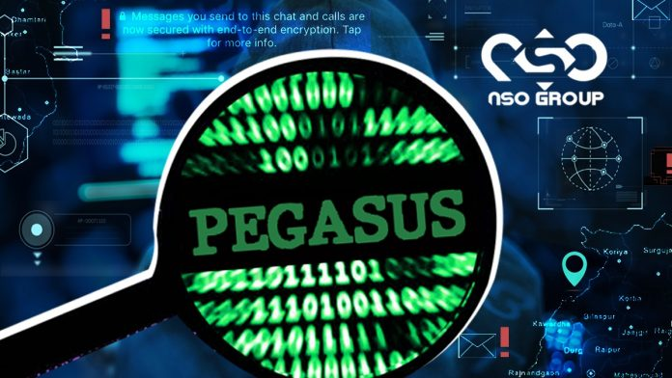
NSO: The Company Against Civil Rights
Dionne Newman
Jace Mau
Annelys King

Slide 2
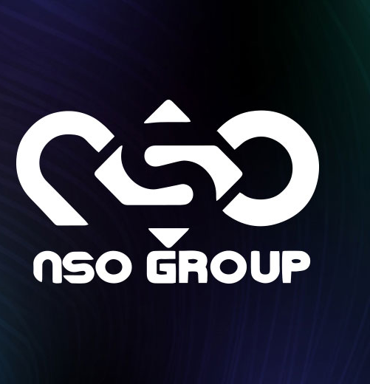
Description/Source
NSO is a company based in Israel that creates spyware like Pegasus.
They distribute spyware to governments who want to spy on HRAs.
They have exploits on iPhones and WhatsApp, which are commonly used.

Slide 3

Motivation/Attack Author(s)
The listed threat actors are governmental bodies.
They utilize the software to tap the phones of their citizens.
They claim this is done as to maintain public safety.
Terrorists could be detected, locations uncovered, etc.

Slide 4
Timeline/Method
2016
Ahmed Mansoor was targeted with Pegasus, and alerted the Citizen Lab
2018
Jamal Khashoggi was killed with the aid of Pegasus
2020
To speak out against NSO, the Pegasus Project was created
2021
Mexico makes their first Pegasus usage-related arrest
2011
The first recorded usage of Pegasus was used to arrest El Chapo, a Mexican drug lord

Slide 5

Consequences of Attack
There are various users whose devices are tapped.
Various attacks were wrongly launched.
User privacy is in question.
Is there cause for a breach of their privacy?
Corrupt governments utilize Pegasus to spy on citizens.
People were killed with the aid of Pegasus.

Slide 6

Defense
Pegasus takes advantage of links; do not click suspicious links.
Was a zero-click exploit; targets could not protect themselves.
Tech companies patched the vulnerabilities used.

